Slide 1



Module 6
XSL and XSLT

Slide 2


Module Overview
In this module, you will learn about:
Introduction to XSL
Working with XSL

Slide 3


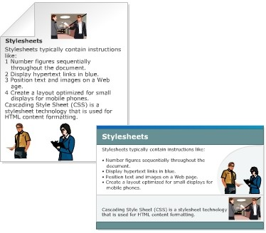
Stylesheets
It is a collection of commands that tells a processor how to render the visual appearance of content in a web page.
CSS is used for HTML content formatting.
XSL is used to describe how the XML document should be displayed.

Slide 4
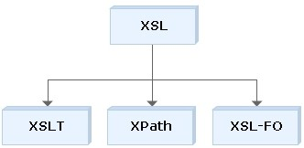
Extensible Stylesheet Language (XSL)
XSL Transformations (XSLT)
An XML language for transforming XML documents.
XML Path Language (XPath)
A language for navigating the XML document.
XSL Formatting Objects (XSL-FO)
An XML language for formatting XML documents.

Slide 5
XSL Transformations
The transformation component of the XSL stylesheet
technology is XSLT.
It describes the process of transforming an XML document, using a transformation engine and XSL.

Slide 6
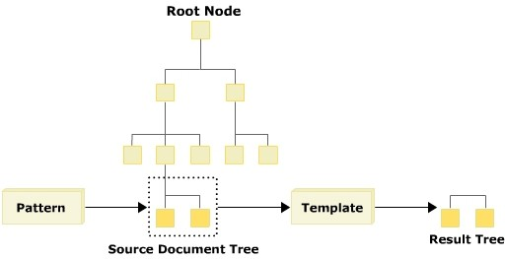
XSL Processing Model
It reads an XML document and processes it into a
hierarchical tree.
It starts with the root node in the tree and performs pattern matching in the stylesheet.

Slide 7
XSLT Structure and Syntax
It uses a standard document introduction, matching closing tags for any opening tags that contain content, and a proper syntax for empty elements.
The style rules are written in a file with the extension
.xsl.
Syntax
<xsl:stylesheet version=”1.0” xmlns:xsl=”http://www.w3.org/1999/XSL/Transform”>
………
………
</xsl:styleheet>
where,
<xsl:stylesheet>: Root element of the stylesheet.
xmlns:xsl=”http://www.w3.org/1999/XSL/Transform”: refers
to the official W3C XSLT namespace. You must include the attribute
version=”1.0” if you use this namespace.

Slide 8


Top Level XSLT Elements
An element occurring as a child of an xsl:stylesheet element is
called a top-level element.
It can occur directly inside the xsl:stylesheet element.
Element Name | Description
xsl:attribute-set | Adds a list of attributes to the output node tree
xsl:import | Used to import contents of one stylesheet into another. The importing stylesheet takes precedence over the imported stylesheet
xsl:namespace-alias | Replaces source document Namespace with a new Namespace in the output tree node
xsl:output | Specifies the output for the result tree. It contains a list of attributes. The most important one is the method attribute which dictates if the type of output is HTML, text, or XML
xsl:template | Used to define a template that can be applied to a node to produce a desired output display
xsl:variable | Defines a variable in a stylesheet or template, and to assign it a value

Slide 9


CSS and XSL
They are two different style languages recommended by the World
Wide Web Consortium (W3C).
XSL is more powerful and complex than CSS.
CSS | XSL
Stylesheet language to create a style for HTML and XML documents | Stylesheet language to create a style for XML documents
Determines the visual appearance of a page, but does not alter the structure of the source document | Provides a means of transforming XML documents
Does not support decision structures and it cannot calculate quantities or store values in variables | Supports decision structures and can calculate quantities or store values in variables
Uses its own notation | Uses an XML notation
Highly effective and easy to learn for simple applications | Designed to meet the needs of more complex applications for richer style sheets

Slide 10
The xsl:template Element
It is used to define a template that can be applied to a node
to produce desired output.
Syntax
<xsl:template match=”pattern” mode=”mode name=”name” priority=”number”
>
</xsl:template>
where,
match: Is a pattern that is used to define which nodes will have which template rules applied to them. If this attribute is omitted there must be a name attribute.
mode: Allows the same nodes to be processed more than once.
name: Specifies a name for the template. If this attribute is omitted there must be a match attribute.
priority: Is a real number that sets the priority of importance for a
template. The higher the number, the higher the priority.

Slide 11

The xsl:apply-templates element 1-4
It defines a set of nodes to be processed.
Syntax
where,
select
Used to process nodes selected by an expression.
mode
Allows the same nodes to be processed more than once. Each time the nodes are processed, they can be displayed in a different manner.

Slide 12
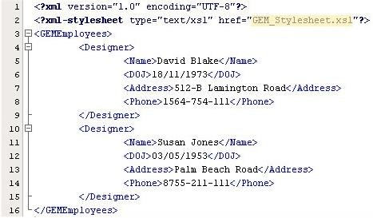
The xsl:apply-templates element 2-4
Code Snippet

Slide 13
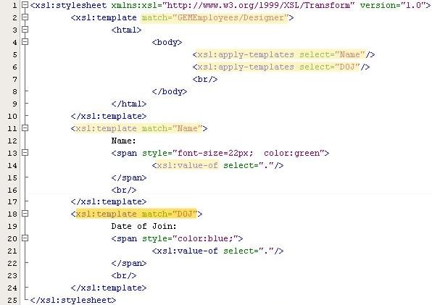
The xsl:apply-templates element 3-4
Style Sheet
where,
match=”GEMEmployees/Designer”
Represents the Designer child element by specifying the GEMEmployees parent element.
xsl:apply-templates select=”Name”
Applies the template on Name element.
xsl:value-of
Used to extract the value of a selected node.
xsl:template match=”Name”
If the template is matched with Name element, the value of the Name element is displayed in green color with font size 22 pixels.
Notes:
Match = “/” ~ match = root = GEMEmployees

Slide 14
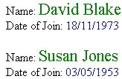
The xsl:apply-templates element 4-4
Output

Slide 15


The select attribute 1-3
It can be used to process nodes selected by an expression
instead of processing all children.
Syntax
where,
select uses the same kind of patterns as the match attribute of the xsl:template element.
If select attribute is not present, all child element, comment, text, and processing instruction nodes are selected.

Slide 16
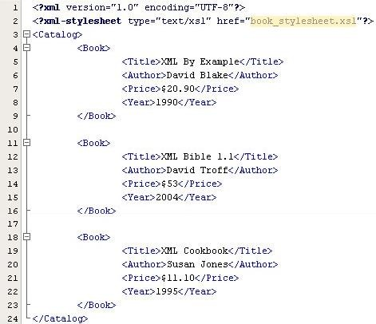
The select attribute 2-3
Code Snippet

Slide 17
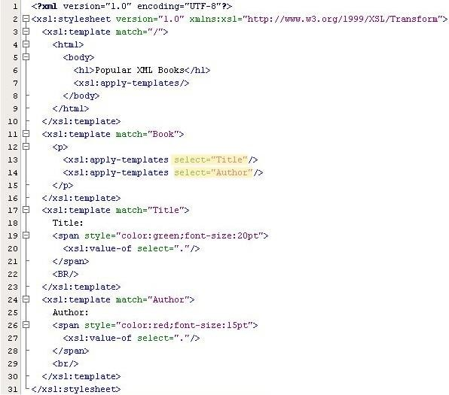
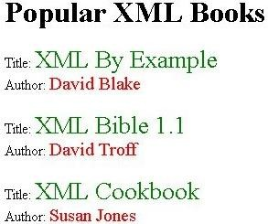
The select attribute 3-3
Style Sheet
Output

Slide 18



The xsl:value-of element 1-3
It is used to write or display text string representing the
value of the element specified by the select attribute.
Syntax
where,
select
A mandatory attribute that assigns the node (by name) to the element.
disable-output-escaping
Specifies how special characters should appear in the output string.
yes
Indicates that special characters should be displayed as is (for example, a < or >). no
Indicates that special characters should not be displayed as is (for example, a > is displayed as &gt;).

Slide 19

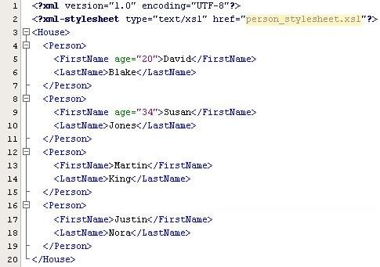
The xsl:value-of element 2-3
Code Snippet

Slide 20

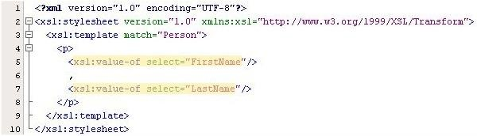

The xsl:value-of element 3-3
Style Sheet
Output
where,
xsl:value-of select=”FirstName”
Display the value of the element FirstName.
xsl:value-of select=”LastName”
Display the value of the element LastName.

Slide 21

The xsl:for-each element 1-3
It can be used to iterate through the XML elements of a
specified node set.
Syntax
where,
select=”expresion”
The expression is evaluated on the current context to determine the set of nodes to iterate over.

Slide 22

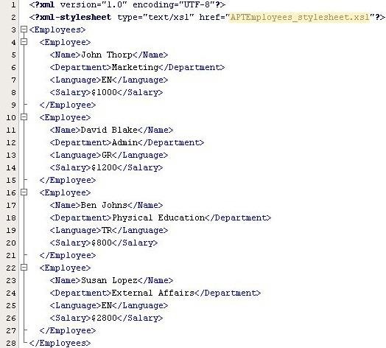
The xsl:for-each element 2-3
Code Snippet

Slide 23


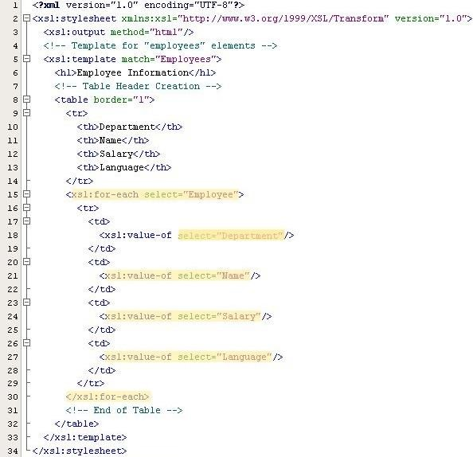
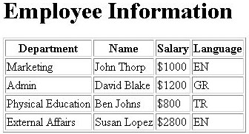
The xsl:for-each element 3-3
Style Sheet
Output

Slide 24


The xsl:text element 1-3
It is used to add literal text to the output.
Syntax
where,
disable-output-escaping
Turns on or off the ability to escape special characters.
yes
If the value is yes, a &gt; will appear as a >.
no
If the value is no, a &gt; will appear as a &gt; in the text.

Slide 25


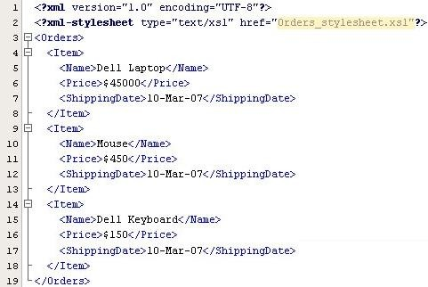
The xsl:text element 2-3
Code Snippet

Slide 26

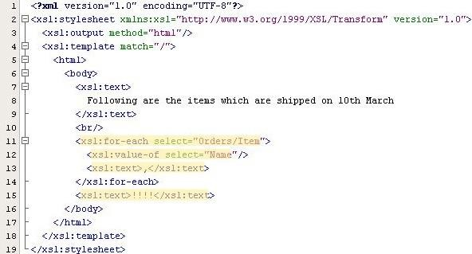

The xsl:text element 3-3
Style Sheet
Output

Slide 27
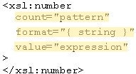
The xsl:number element 1-3
It can be used to determine the sequence number for the
current node.
Syntax
where,
count=”pattern”
Indicates what nodes are to be counted. Only nodes that match the pattern are counted.
format=”{ string }”
Sequence of tokens that specifies the format to be used for each number in the list.
value=”expression”
Specifies the expression to be converted to a number and output to the result tree.

Slide 28
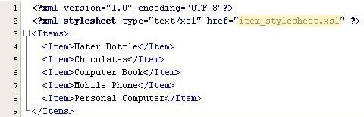
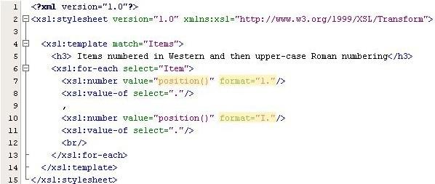
The xsl:number element 2-3
Code Snippet
where,
position()
The current node’s position in the source document.
format=”1.”
User-provided number starts with 1.
format=”I.”
User-provided roman number starts with I.
Style Sheet

Slide 29
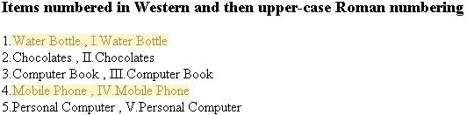
The xsl:number element 3-3
Output
where,
1.Water Bottle, I.Water Bottle
The first item is numbered with number 1 and roman number I.
4.Mobile Phone, IV. Mobile Phone
The fourth item is numbered with number 4 and roman number IV.

Slide 30

The xsl:if element 1-3
Evaluates a conditional expression against the content of the
XML file.
Syntax
where,
test=expression
The condition in the source data to test with either a true or false.

Slide 31
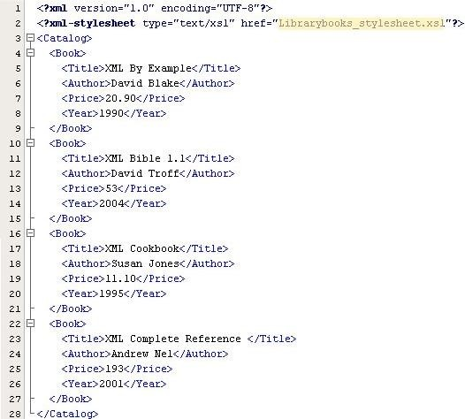
The xsl:if element 2-3
Code Snippet

Slide 32
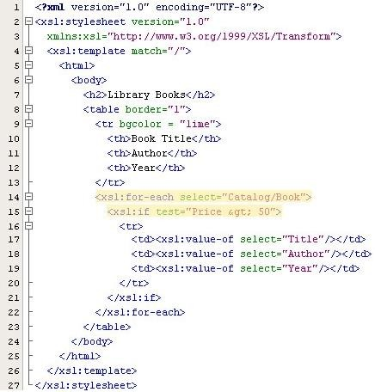
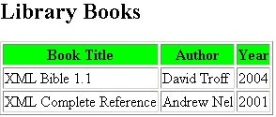
The xsl:if element 3-3
Style Sheet
Output

Slide 33
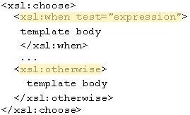
The xsl:choose element 1-3
It is used in conjunction with xsl:when and xsl:otherwise
to express multiple conditional tests.
Syntax
where,
xsl:when test=”expression”
The xsl:when element is examined in the order of occurrence. If the test expression is true, the code contained in that element is executed. xsl:otherwise
If all the test conditions in any xsl:when element are false, then the
xsl:otherwise element is automatically selected and the code associated with
that element is executed.

Slide 34

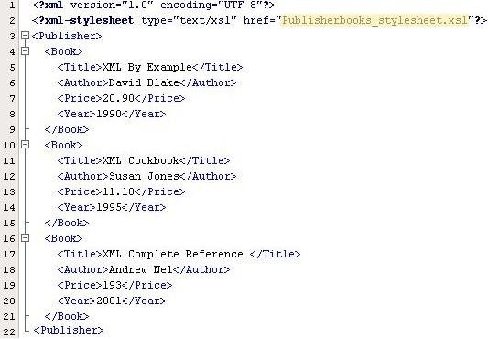
The xsl:choose element 2-3
Code Snippet

Slide 35

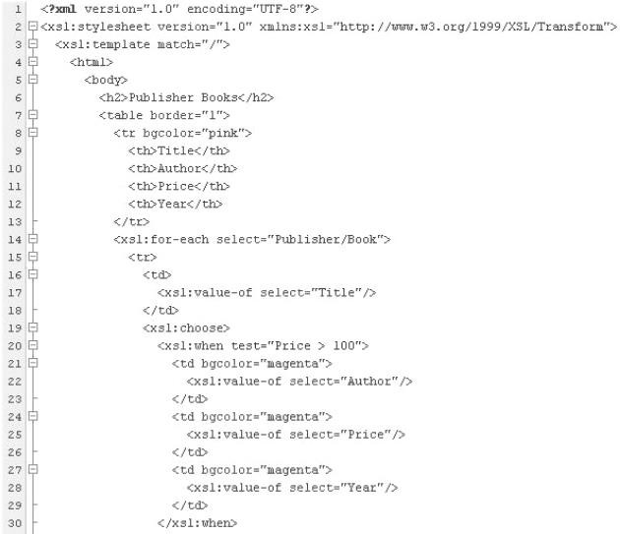
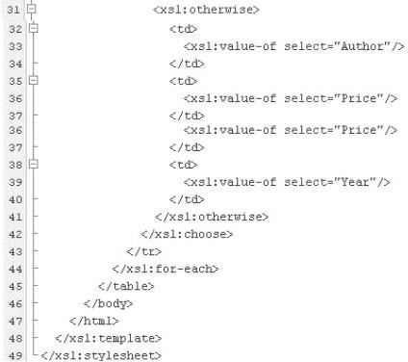
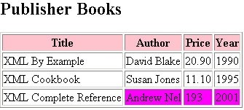
The xsl:choose element 3-3
Style Sheet
Output

Slide 36
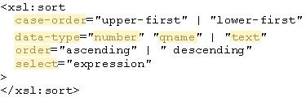
Sorting in XSLT 1-3
It can be used to sort a group of similar elements.
Syntax
where,
case-order
Indicates whether the sort will have upper or lowercase letters listed first in the sort output. The default option is to list uppercase first.
data-type: Specifies the data type of the strings.
Number: Sort key is converted to a number.
Qname: Sort is based upon a user-defined data type.
Text: Specifies that the sort keys should be sorted alphabetically.
Order: The sort order for the strings. The default value is “ascending”.
Select: Expression that defines the key upon which the sort will be based. The expression is
evaluated and converted to a string that is used as the sort key.

Slide 37
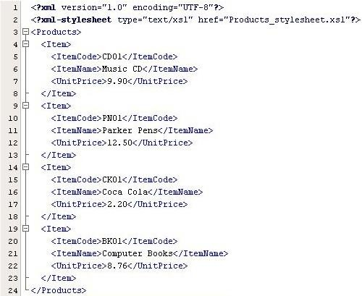
Sorting in XSLT 2-3
Code Snippet

Slide 38
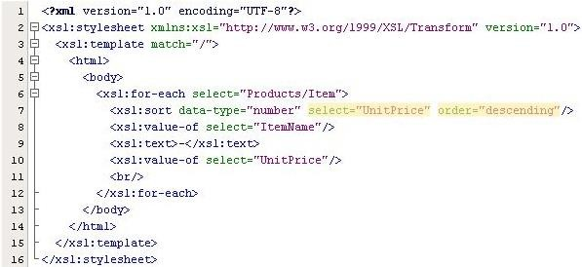

Sorting in XSLT 3-3
Style Sheet
Output

Slide 39
Summary
Introduction to XSL
XML provides the ability to format document content.
XSL provides the ability to define how the formatted XML content is presented.
An XSL Transformation applies rules to a source tree read from an XML document to transform it into an output tree written out as an XML document.
Working with XSL
An XSL template rule is represented as an xsl:template element.
You can process multiple elements in two ways: using the
xsl:apply-templates element and the xsl:for-each element.
The xsl:stylesheet element allows you to include a stylesheet directly in the document it applies to.
The xsl:if element produces output only if its test attribute is
true.

